Slide 1
Operating Systems (CSC 2205)
Instructor: Mr. Khwaja Bilal Hassan
BS CS UET Peshawar
M.Phil. CS Quaid-e-Azam University Islamabad
Lecture#13
Virtual Memory, Demand Paging page replacement algorithms

Slide 2
Week12 Lec 2

Slide 3
Agenda for Today
Virtual Memory
Page Fault
Page replacement
FIFO
LRU
Optimal
LFU
MFU

Slide 4
Fundamentals
Virtual memory can be implemented via:
Demand paging
Demand segmentation

Slide 5
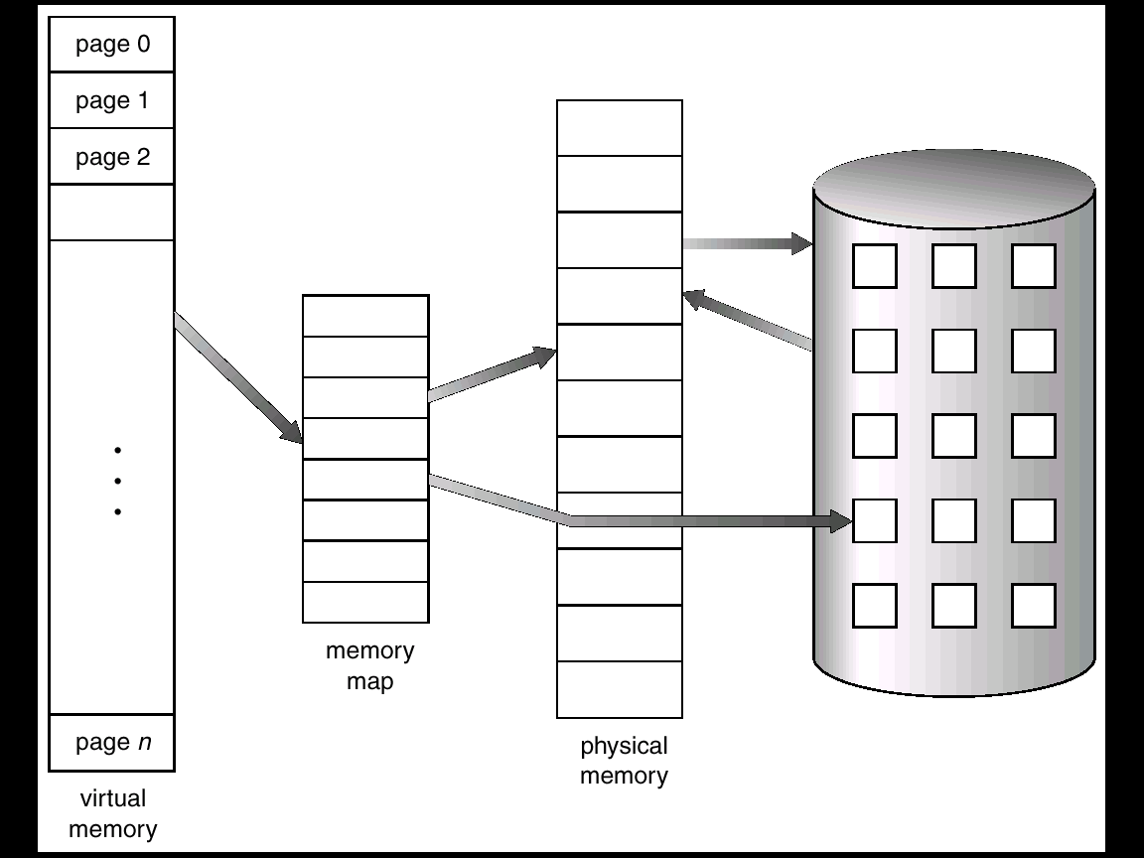
The Basic Idea
Secondary Storage

Slide 6
Demand Paging
Bring a page into memory only when it is needed
Potentially less I/O needed
Potentially less memory needed
Faster response
Higher degree of multiprogramming

Slide 7
Demand Paging
Page is needed ⇒ a reference is made to it
Invalid reference ⇒ abort
Not-in-memory
⇒ page fault
⇒ bring page to memory
No free frame ⇒ swapping (out and in)

Slide 8
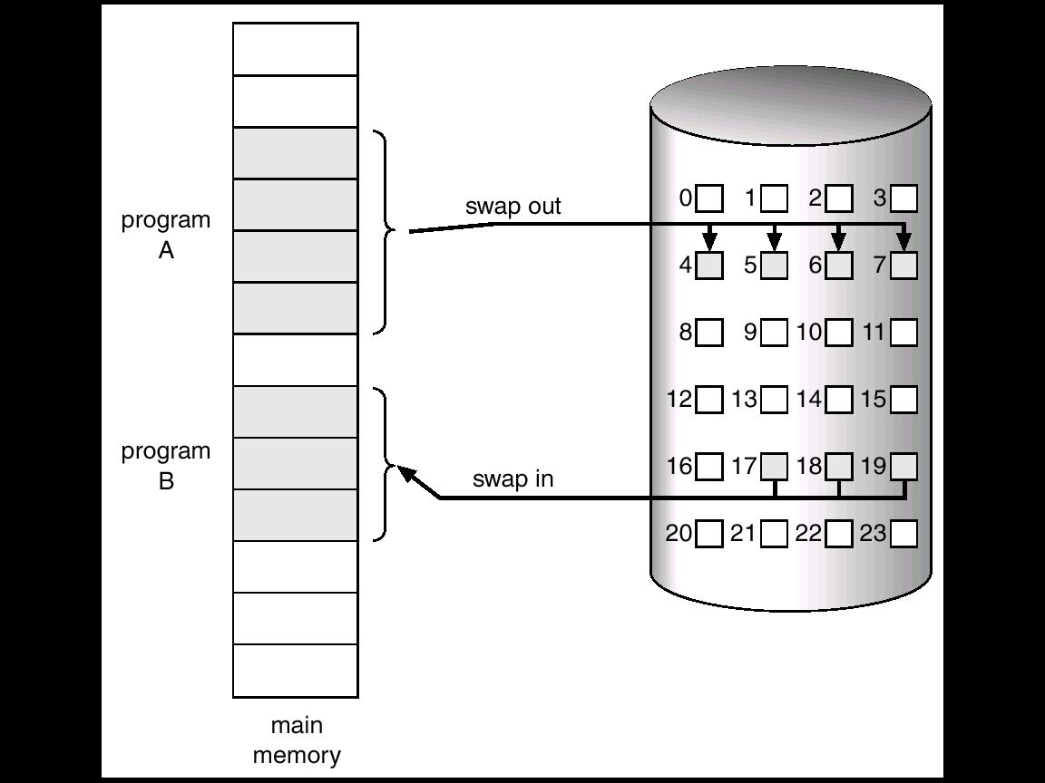
Swapping

Slide 9
Valid-Invalid Bit
With each page table entry a valid–invalid bit is associated (1 ⇒ in-memory, 0 ⇒ not-in-memory)
Initially valid–invalid but is set to 0 on all entries

Slide 10
Valid-Invalid Bit
During address translation, if valid–invalid bit in page table entry is 0 ⇒ page fault.
Frame #
valid-invalid bit
1
1
1
1
0

0
0
page table

Slide 11
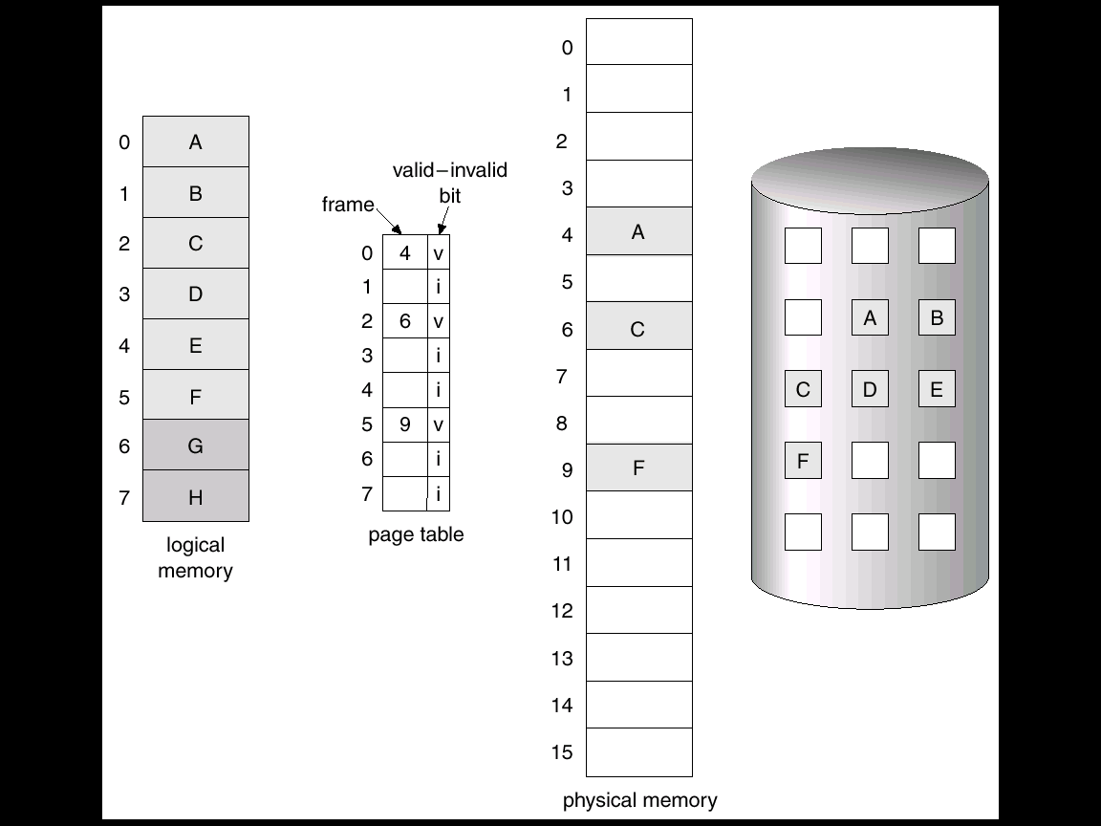
Demand Paging

Slide 12
Page Fault
If there is ever a reference to a page, first reference will trap to OS ⇒ page fault
OS decides
Invalid reference ⇒ trap to OS ⇒ abort process
Just not in memory ⇒ page fault ⇒ service page fault

Slide 13
Page Fault
Allocate an empty frame
Locate the desired page on disk
Swap in the desired page into the newly allocated frame.
Store the frame number in the appropriate page table entry
Reset tables; set valid/invalid bit to 1
Restart instruction

Slide 14
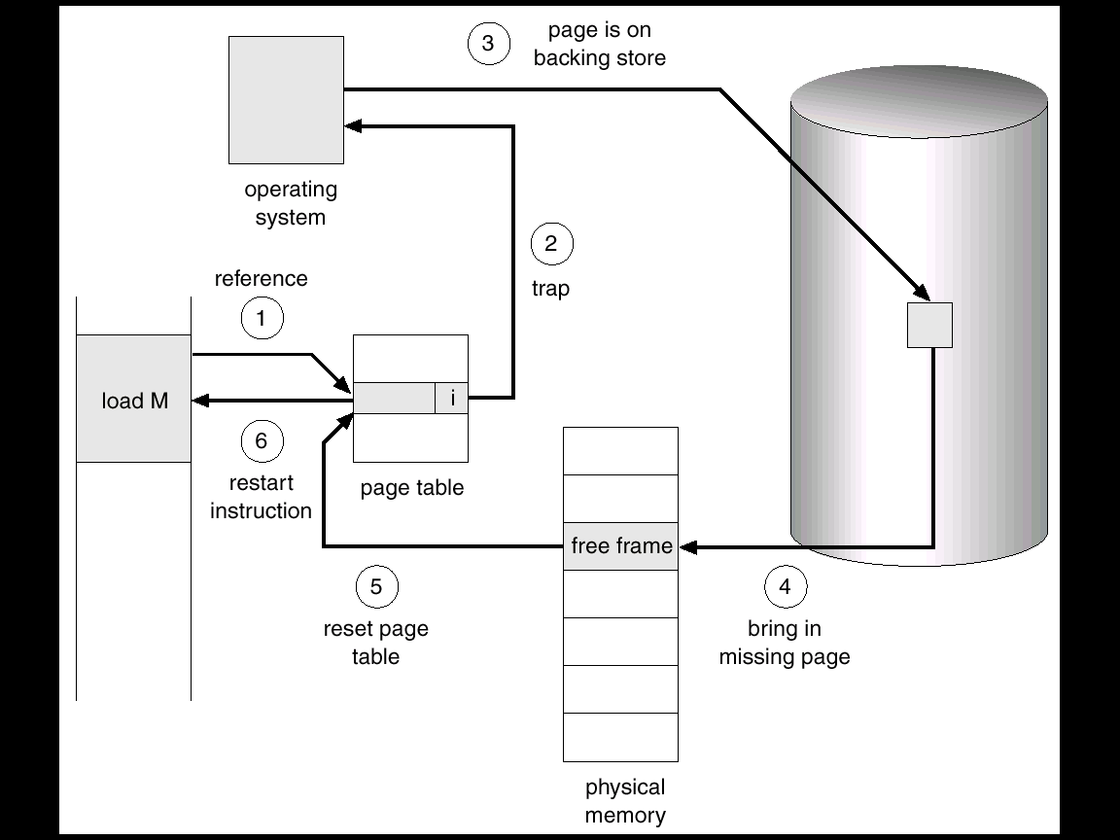
Servicing a Page Fault

Slide 15
Page Replacement
If no free frame is available on a page fault, replace a page in memory to load the desired page
Page-fault service routine is modified to include page replacement.

Slide 16
Page Replacement
Use modify (dirty) bit to reduce overhead of page transfers – only modified pages are written to disk.
Set by hardware when data is written to a page
Checked by OS at page replacements

Slide 17
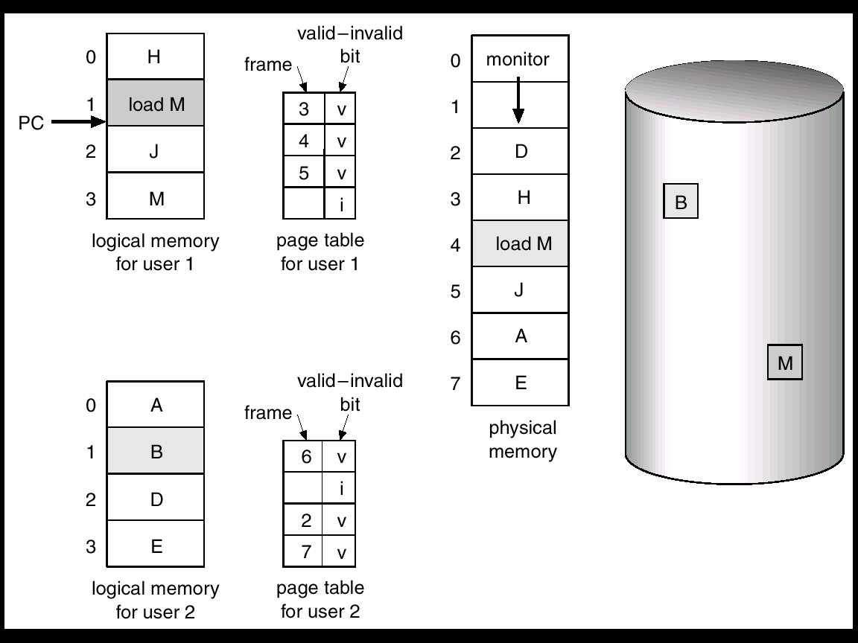
Page Replacement

Slide 18
Page Replacement
M

Slide 19
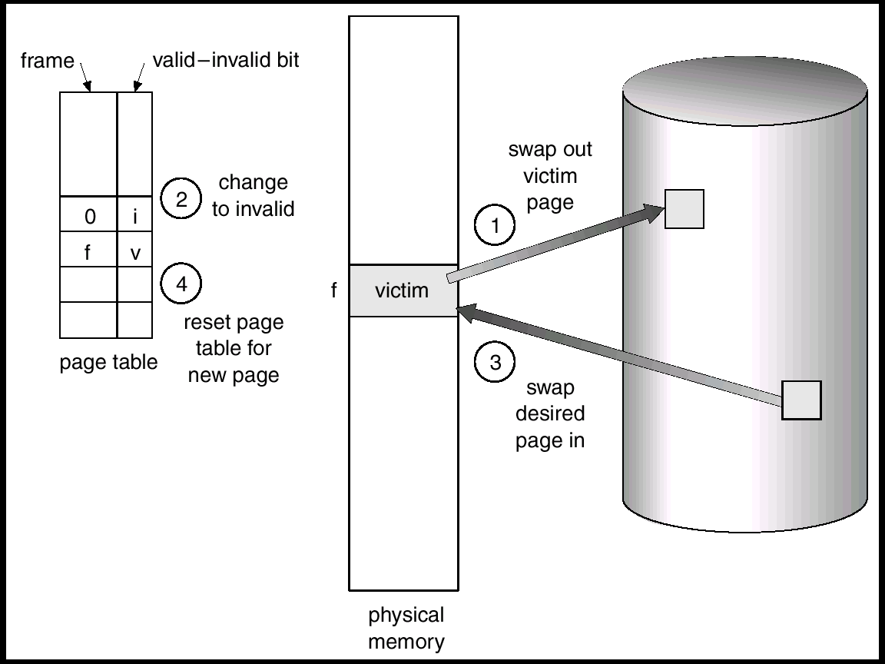
Page Replacement

Slide 20
Page Replacement Algorithms
Want lowest page-fault rate.
Evaluate algorithm by running it on a particular string of memory references (reference string) and computing the number of page faults on that string.

Slide 21
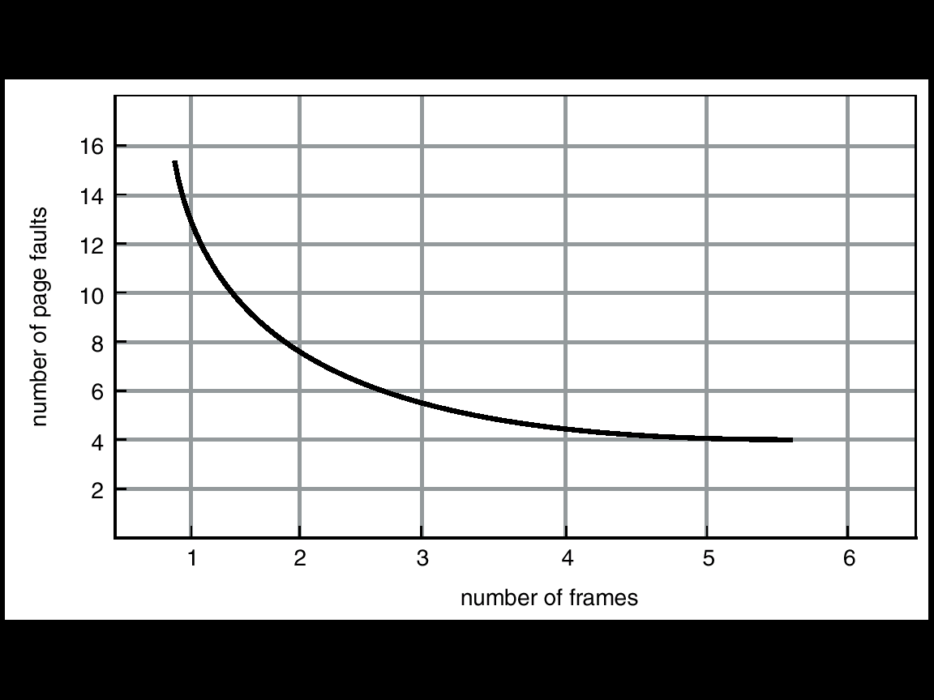
Page Faults vs. Number of Frames

Slide 22
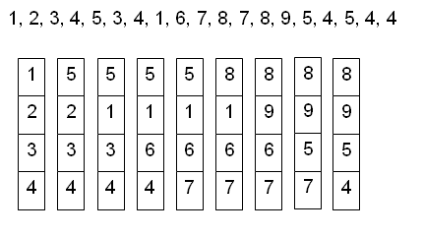
FIFO Algorithm
Number of frame allocated = 4

Slide 23
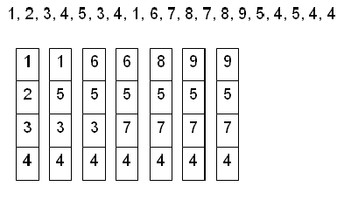
Optimal Algorithm
Replace the page that will not be used for the longest period of time.

Slide 24
Least Recently Used (LRU) Algorithm
Replace the page that hasn’t been used for the longest period of time.

Slide 25
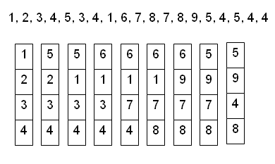
LRU Example

Slide 26
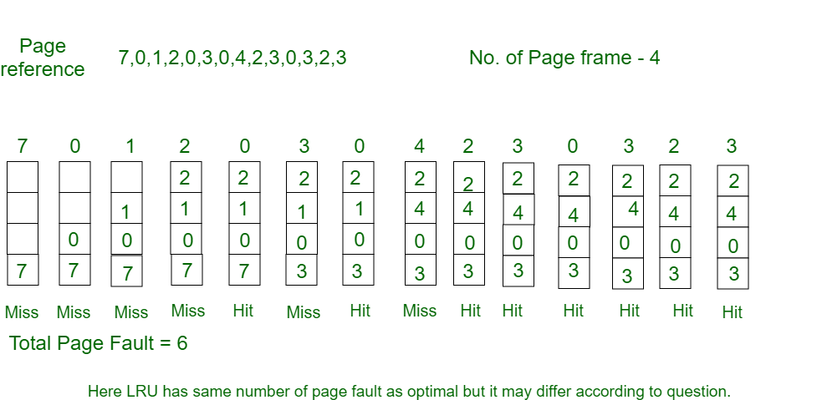

Slide 27
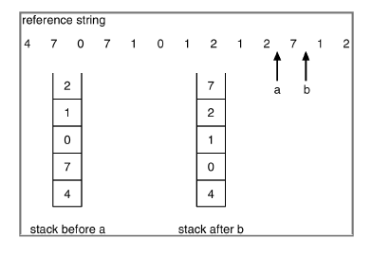
LRU Implementation

Slide 28
Optimal Page Replacement
In this algorithm, pages are replaced which would not be used for the longest duration of time in the future.
Consider the page references 7, 0, 1, 2, 0, 3, 0, 4, 2, 3, 0, 3, 2, with 4 page frame. Find number of page fault

Slide 29
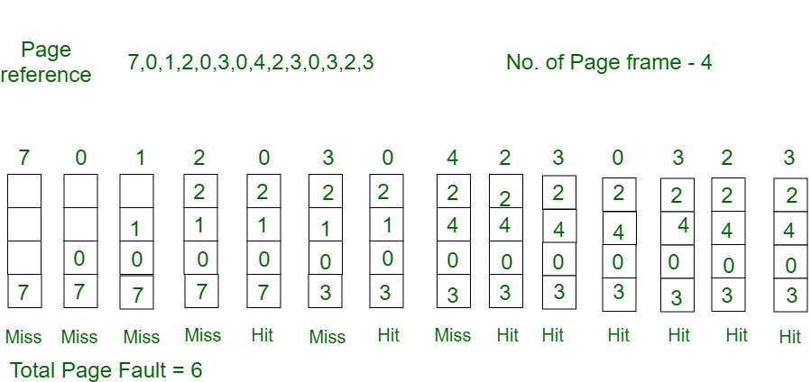
Optimal Page Replacement

Slide 30
Least Frequently used
This algorithm is not for placement course.
But basically in current stack at any iteration we choose that element for replacement which has smallest count in the incoming page stream.

Slide 31
Most Frequently Used
Most Frequently Used (MFU)
The page with the smallest count was probably just brought in and has yet to be used; it will be in the locality that has just started.

Slide 32
Belady’s Anomaly
“For some page replacement algorithms, the page fault rate may increase as the number of allocated frames increases.”

Slide 33
Page Faults vs. Number of Frames

Slide 34
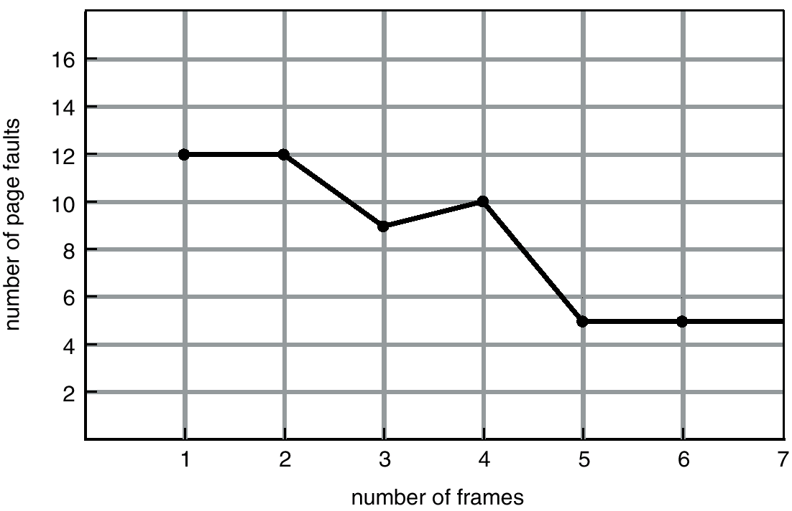
Belady’s Anomaly

Slide 35
Thrashing
If a process does not have “enough” pages, the page-fault rate is very high. This leads to:
Low CPU utilization
Operating system thinks that it needs to increase the degree of multiprogramming.
Another process added to the system—serious problem!

Slide 36
Thrashing
A process is thrashing if it is spending more time paging (i.e., swapping pages in and out) than executing
Thrashing results in severe performance problems
Low CPU utilization
High disk utilization
Low utilization of other I/O devices

Slide 37
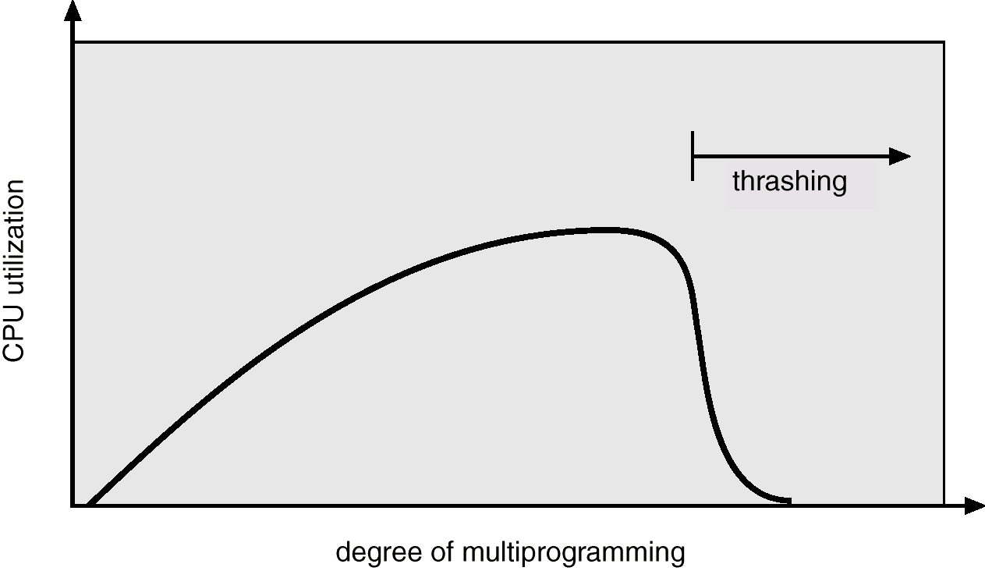
Thrashing

Slide 38
Thrashing
To stop thrashing, the degree of multiprogramming needs to be reduced
Local page replacement prevents thrashing to spread among several processes
However, a thrashing process consumes more resources

